Slide 1

Sentiment Analysis with Stress Detection Using Audio Samples

Slide 2
Problem Statement
Voice stress analysis (VSA) is collectively a pseudo-scientific technology that aims to infer deception from stress measured in the voice.
CONV1DV

Slide 3
Packages to be Used
TensorFLow
Scikit-Learn
Librosa(audio library)
Keras
Ploty,matplotlib
Pandas,numpy,
Evaluation Metrics : Recall , Precision , Fscore

Slide 4
Abstract
This technology aims to differentiate between stressed and non-stressed outputs in response to stimuli (e.g., questions posed), with high stress seen as an indication of deception. In this work, we propose a deep learning-based psychological stress detection model using speech signals. With increasing demands for communication between humans and intelligent systems, automatic stress detection is becoming an interesting research topic. Stress can be reliably detected by measuring the level of specific hormones (e.g., cortisol), but this is not a convenient method for the detection of stress in human- machine interactions. The proposed algorithm first extracts Mel- filter bank coefficients using pre-processed speech data and then predicts the status of stress output using a binary decision criterion (i.e., stressed or unstressed) using CNN (Convolutional Neural Network) and dense fully connected layer networks.

Slide 5
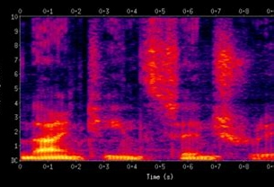
Spectrogram Random Example
Time vs Frequency

Slide 6
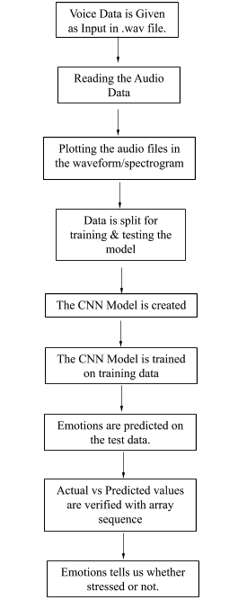
Flow Diagram

